Slide 1
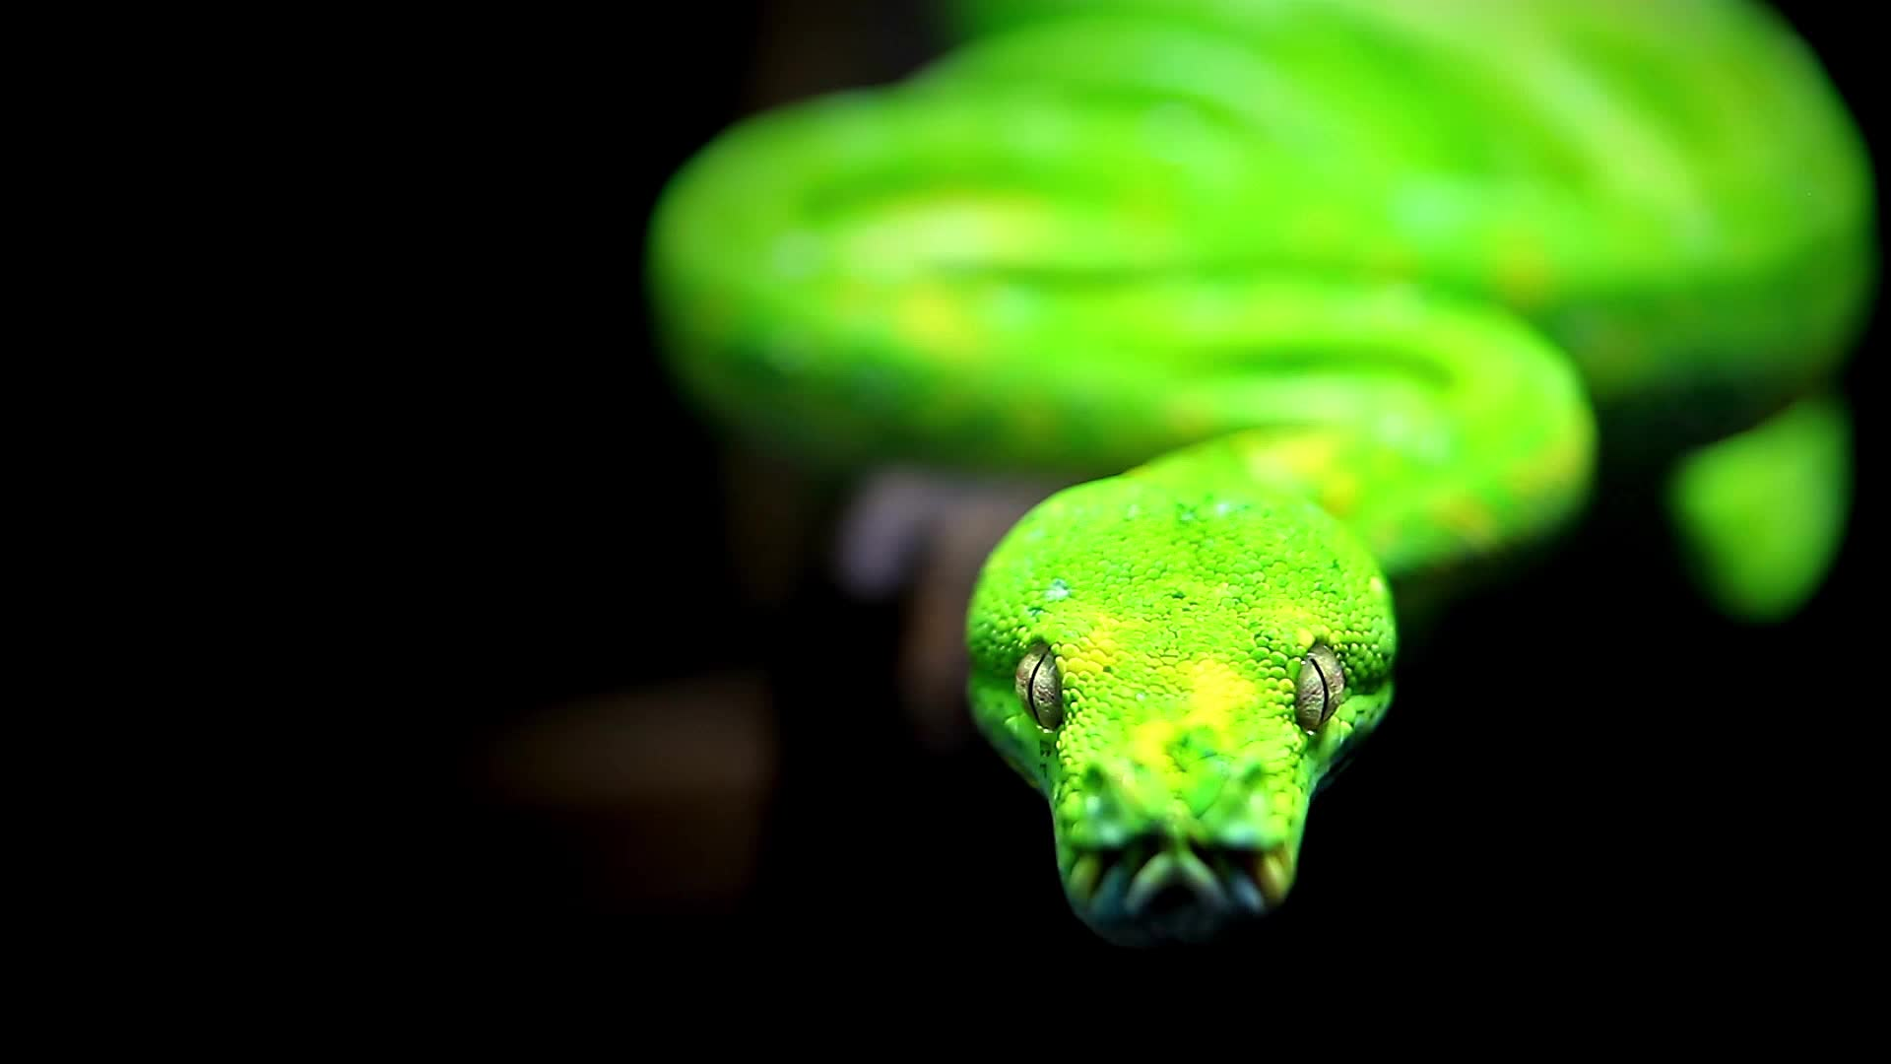
Practical use of @decorators in Python
Introduced by:
Krzysztof Stefański Mateusz Setkowicz
18.05.2023

Slide 2
Agenda
A reminder about Python functions - funcion as an object - closures, nesting, scopes - references in functions
What is a decorator - function-based decorators - class-based decorators
Why? For What? Where? - ods and cons - build in decorators - practical usage
Our project!

Slide 3
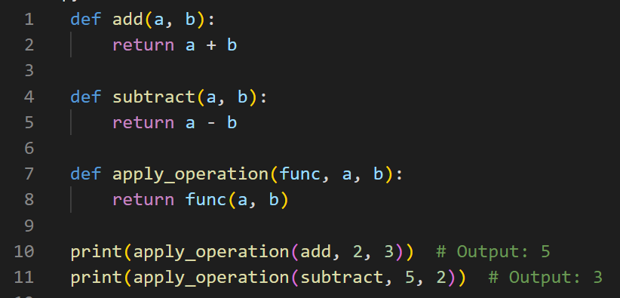
Functions
Can be passed as arguments to other functions
Can be returned as values from other functions
Can be assigned to variables
Can be defined inside other functions
Can be stored in data structures such as lists or dictionaries
Varibles are references to objects

Slide 4
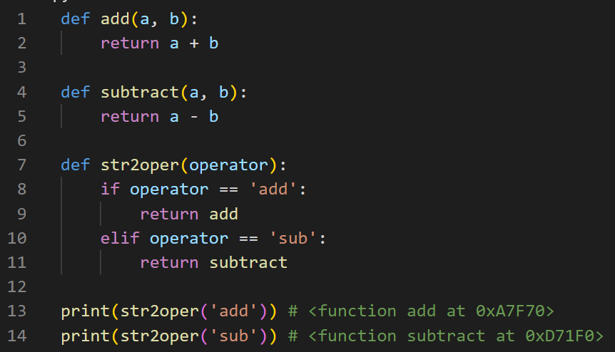
Functions
Can be passed as arguments to other functions
Can be returned as values from other functions
Can be assigned to variables
Can be defined inside other functions
Can be stored in data structures such as lists or dictionaries
Varibles are references to objects

Slide 5
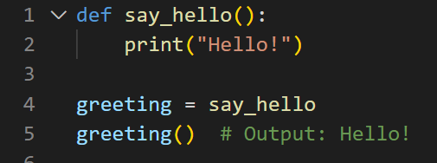
Functions
Can be passed as arguments to other functions
Can be returned as values from other functions
Can be assigned to variables
Can be defined inside other functions
Can be stored in data structures such as lists or dictionaries
Varibles are references to objects

Slide 6
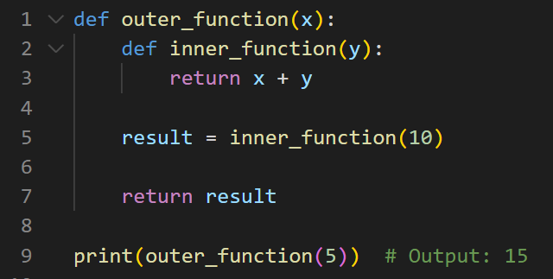
Functions
Can be passed as arguments to other functions
Can be returned as values from other functions
Can be assigned to variables
Can be defined inside other functions
Can be stored in data structures such as lists or dictionaries
Varibles are references to objects
[Nested functions]

Slide 7
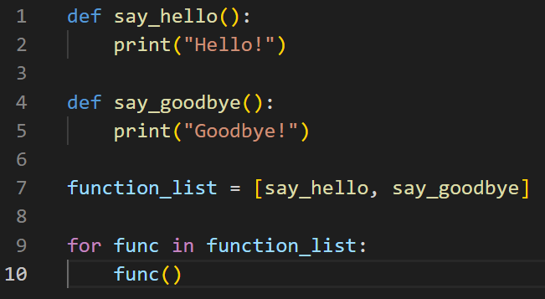
Functions
Can be passed as arguments to other functions
Can be returned as values from other functions
Can be assigned to variables
Can be defined inside other functions
Can be stored in data structures such as lists or dictionaries
Varibles are references to objects

Slide 8
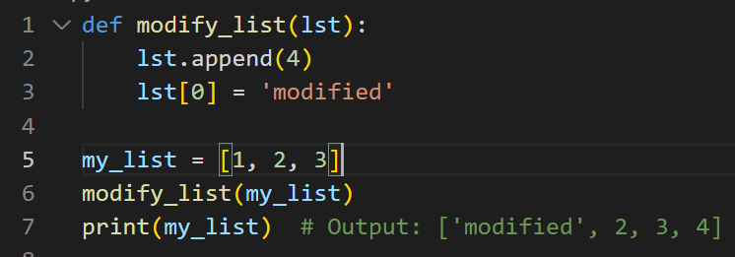
Functions
Can be passed as arguments to other functions
Can be returned as values from other functions
Can be assigned to variables
Can be defined inside other functions
Can be stored in data structures such as lists or dictionaries
Varibles are references to objects

Slide 9
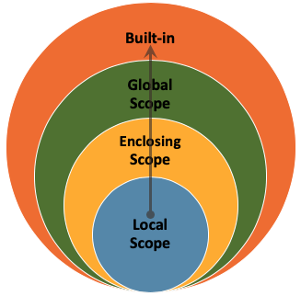
closures, nesting, scopes

Slide 10
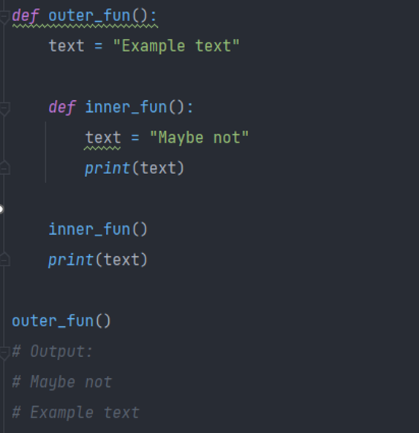
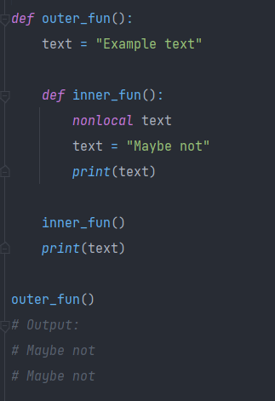
Clousers

Slide 11
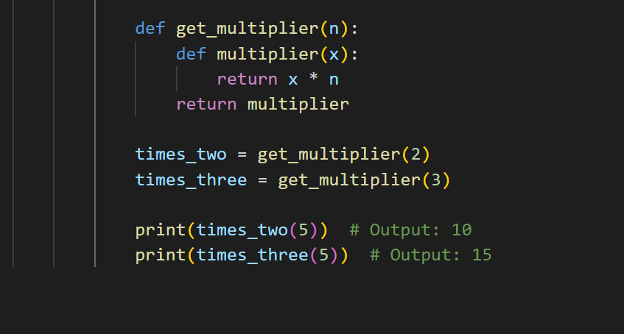
Closures
get_multiplier returns a reference to the multiplier
A function that captures the state of its environment when its created.

Slide 12


What is decorator?
Decorator is essentaily a closure that takes a function as its argument and returns a new function that modifies the bahaviour of the original function.
@classmethod @deprecated @property @wraps @timing @log @staticmethod @abstractmethod @retry @cache @synchronize @json_load @register

Slide 13
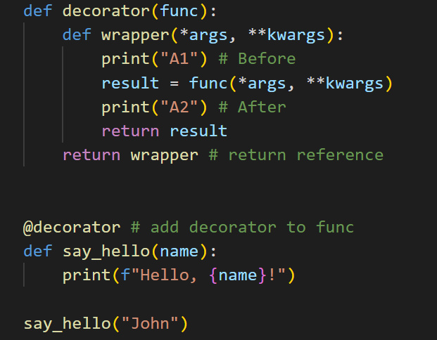
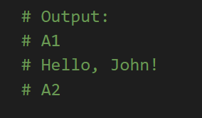
Function-Decorators
Syntax „@” basically does this: say_hello = decorator(say_hello)

Slide 14
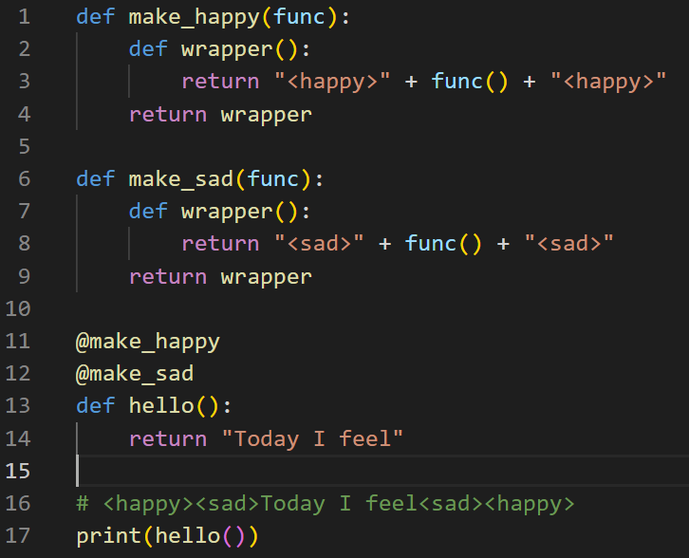
decorator chaining
hen hello() is called, it's actually the innermost wrapper function that's called first (i.e., make_italic), followed by the outer wrapper function (i.e., make_bold).
When hello() is called, it's actually the innermost wrapper function that's called first (i.e., make_sad), followed by the outer wrapper function (i.e., make_happy).

Slide 15
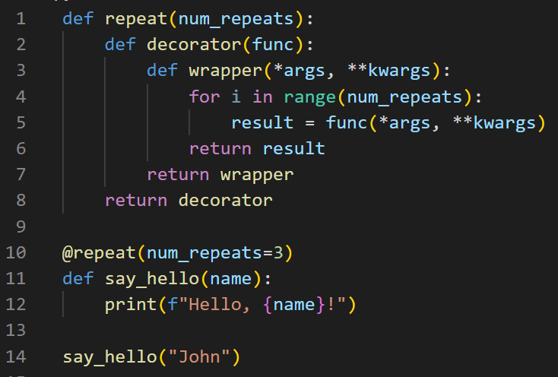
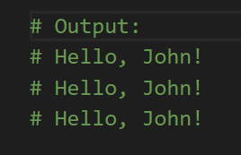
parameterized decorator
Parameterized decorator is a decorator that can be customized by passing arguments to it at the time of decoration.

Slide 16
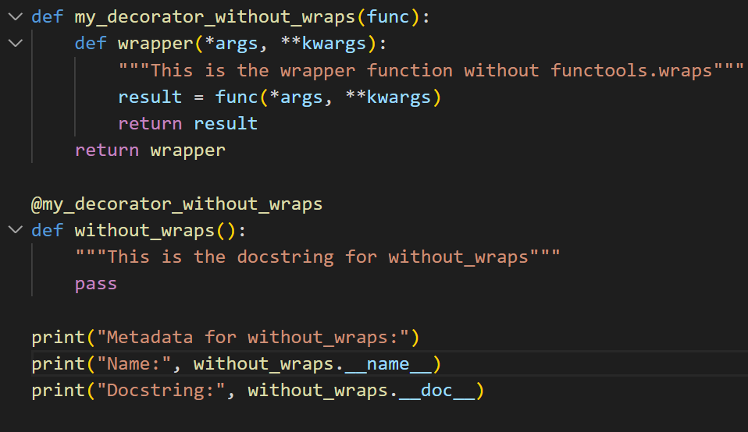
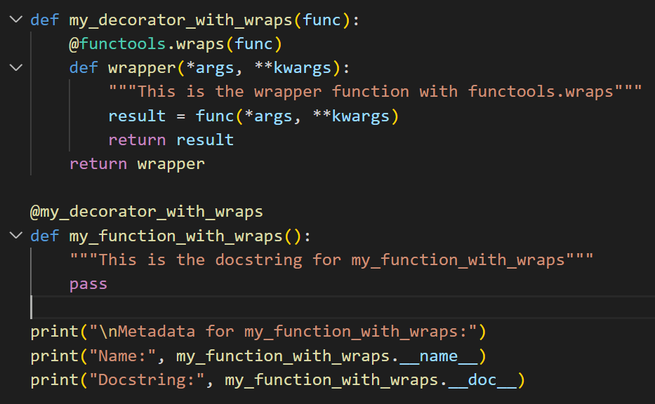
@functools.wraps
Notes:
Decorators do not carry the name of the function, so debugging can be problematic. Fortunately, since Python 2.5 there is a solution to this issue.
The module contains functools.wraps which solves the issue mentioned earlier. It decorates fun_wrapper and updates its attributes to those of an original function.

Slide 17
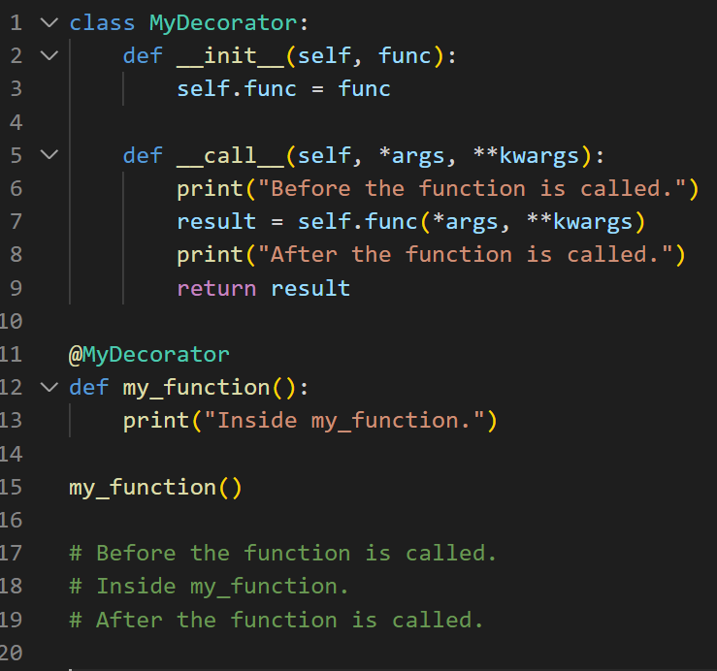
Class-based Decorator
The __init__() method takes a function as an argument and stores it as an instance variable. The __call__() method is called when the decorated function is called

Slide 18
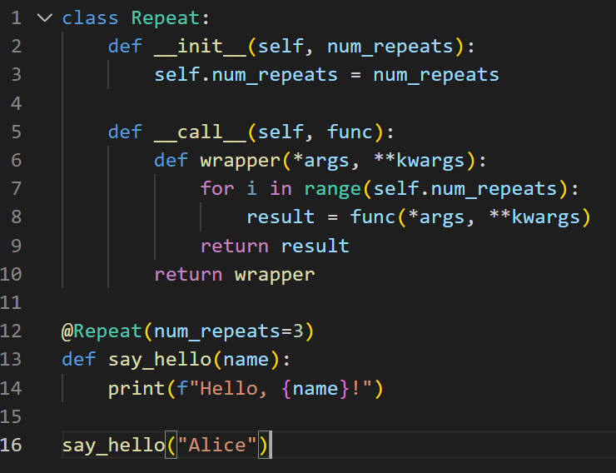
Other examples

Slide 19
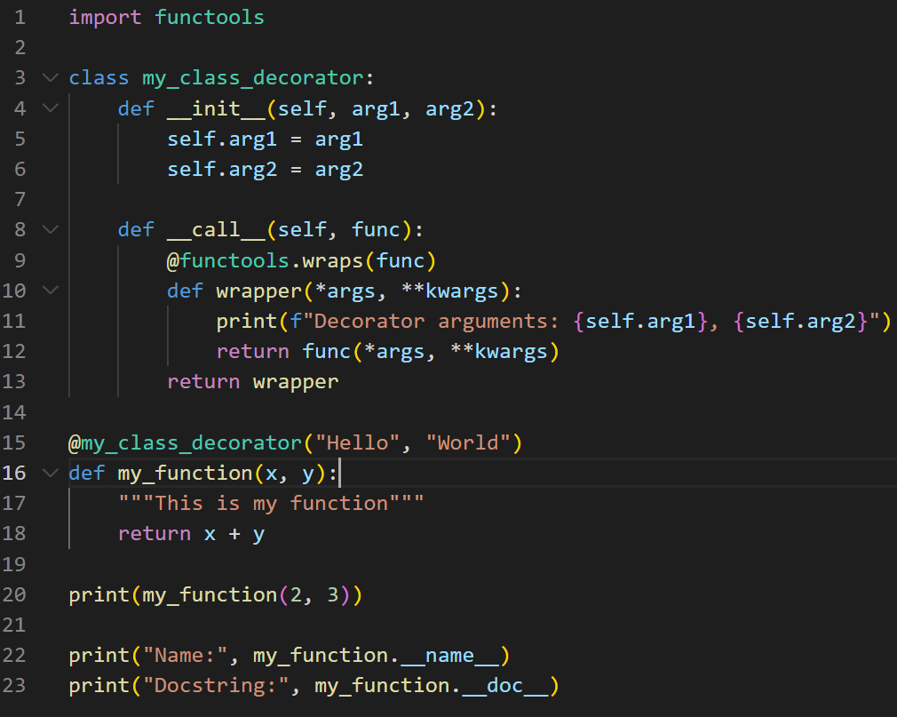
Other examples

Slide 20

buildin decorators / practical usage

Slide 21
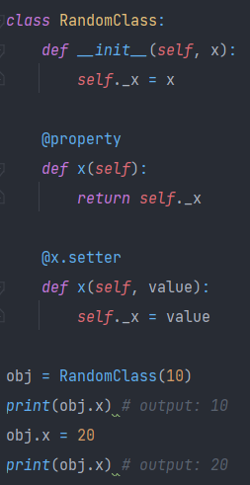

@Property
By adding @property to a method, you can make that method behave like a read-only attribute of the class.
On the other hand, using @<var_name>.setter allows you to customize the behavior of setting the value of an attribute.

Slide 22
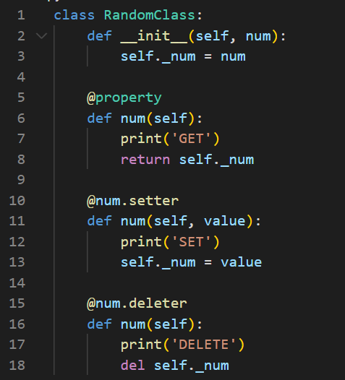
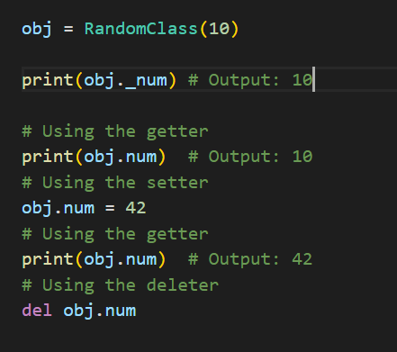
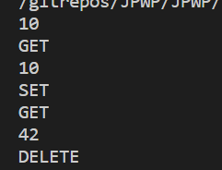
Other examples

Slide 23
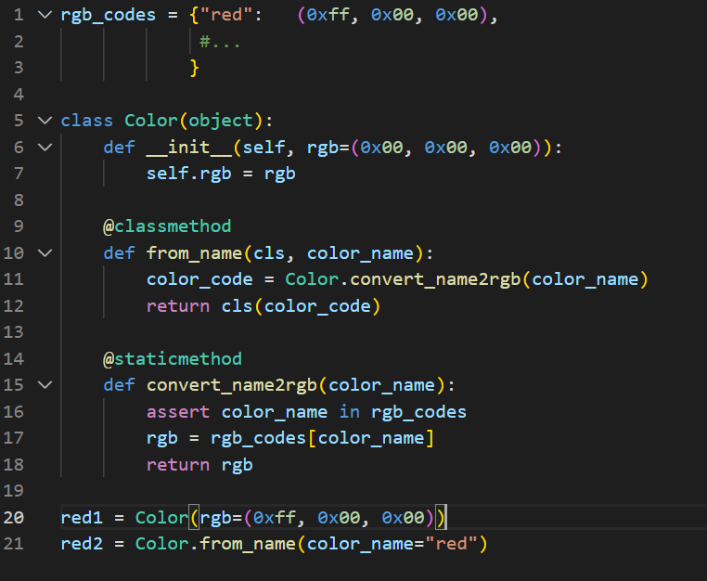

@staticmethod @classmethod
Decorators that are used to define methods within a class

Slide 24
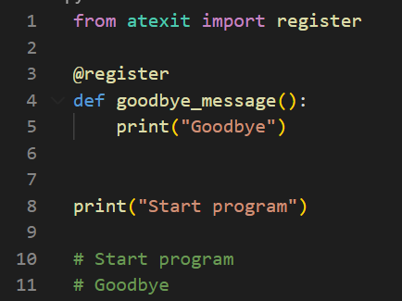

Atexit @register
The register decorator names a function to be ran at termination. This would work whenever you need to save some data before program exit.

Slide 25

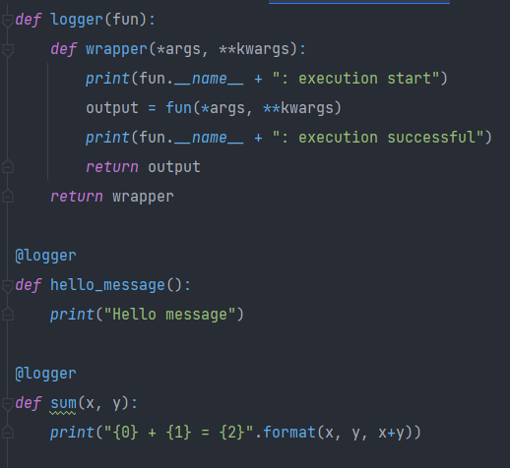
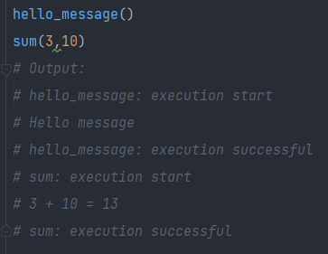
Custom @Logger!

Slide 26
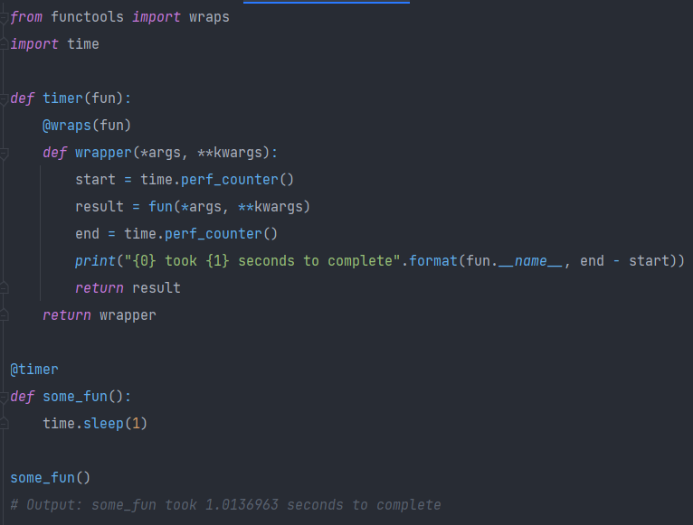

Custom @timer!

Slide 27
Where can TO used @THEM?
Testing code performance (Timing)
Authorization
Logging data
Data Caching
Validation
Testing and debugging
Error handling
Retry calls

Slide 28
Why to use @them?
Modularity: You can keep your code modular and reusable
Readability: Decorators can make your code more readable and easier to understand
Flexibility: You can modify the behaviour of existing code without deep interference
Maintability: Using decorators might make your code more maintainable
Customization: You can quite easily customize the behaviour of your code to your needs
DRY: Don’t repeat yourself, decorators help to reduce repetitions in code

Slide 29

PEP 0318 -- Decorators for Functions and Methods Bruce Eckel on decorators with arguments Yet another Guide to Decorators – the codeship
Python Decoration Library
This Photo by Unknown Author is licensed under CC BY-SA

Slide 30

Project
Compact Rest API backend - CRAB

